Slide 1
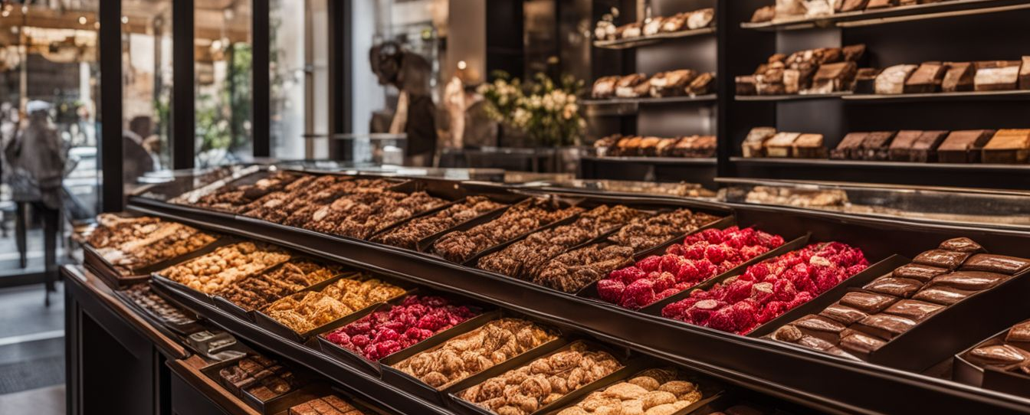

Project name: CHOCOLATE Store
Presented by: Nehal Momtaz Date: April 2026

Slide 2
Executive Summary
Comprehensive analysis of CHOCOLATE Store sales and operations was conducted using Power BI.
Dashboard focuses on revenue, profit, customer behavior, and store performance.
Key goal: Increase profitability & sales growth

Slide 3
Key KPIs Overview
For years 2023 & 2024
Total Revenue
Total Profit
Average Chocolates per Order
Profit Margin %
Profit performance
Sales performance
Top 2 countries in profit
Top 2 months in profit

Slide 4
Sales & profit Performance Analysis
Top brands drive sales.
Demand varies by category.
Prioritize best-selling products.
Relation between sales & profit

Slide 5
Customer Behavior Analysis
Orders by gender and loyalty.
Repeat customers matter.
Will customer behavior changed in specific periods in the year

Slide 6
Store Performance Analysis
No. of stores per country
No. of stores per year
Relation between stores no. , sales & profit accordingly

Slide 7
Insights
We have noticed some points:
We have slight increase in profit per year
There are direct relation between profit & orders no, where highest profit is located in type of stores that have highest no. of orders in (Airport stores)
We have a good gross profit margin
We have high demand on specific chocolate brand & category
No. of loyal customers are almost equals non-loyal customers
Chocolate sales is not depending on customer gender
There are direct relation between stores no. & orders no. , where highest demand is located in type of stores that have highest no. of stores in (Airport stores)
We still need more data about expenses (staff salaries, branch rents,….) in order to calculate net profit margins, to have more clear image

Slide 8
Strategic Recommendations
Focusing on Top-profit products
Need to prepare Loyalty/retention programs (training Quality control & customer service teams)
Increasing no. of retail stores
Increasing online sales by (increasing advertising - customer retention to gain high ratings – making more Bundles (“Buy 2 Save 15%”)
Making more offers & new products in Peak Sales Months
Control costs

Slide 9
Thank You
Questions & Discussion

